Slide 1
4-BIT EVEN PARITY CHECKER
NAME | USN
Shradha Mallikarjun Patil | 2GI20CS144
Srushti B Mudennavar | 2GI20CS158
Sushmita G Kulali | 2GI20CS163
Vani F Dodamani | 2GI20CS172

Slide 2
TABLE OF CONTENTS:
Introduction
Parity Generator
4-Bit Even Parity Generator
Conclusion
References

Slide 3
INTRODUCTION:
In digital electronic systems, during data transmission and processing, data gets distorted. This is due to the noises added to it. Such noises change 0s to 1s and 1s to 0s.
Hence, a Parity Bit is added to the word containing data in order to make number of 1s either even or odd. The message containing the data bits along with parity bit is transmitted from transmitter to the receiver.
At the receiving end, the number of 1s in the message is counted and if it doesn’t match with the transmitted one, it means there is an error in the data.

Slide 4
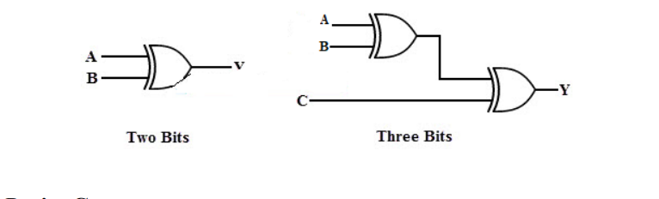
PARITY GENERATOR PRINCIPLE AND WORKING:
The basic principle involved in the implementation of parity circuits is that sum of odd number of 1s is always 1 and sum of even number of 1s is always zero.
The sum of the data bits and parity bits can be even or odd. In even parity, the added parity bit will make the total number of 1s an even amount whereas in odd parity the added parity bit will make the total number of 1s odd amount.
Such error detecting and correction can be implemented by using Ex-OR gates (since Ex-OR gate produce zero output when there are even number of inputs).

Slide 5
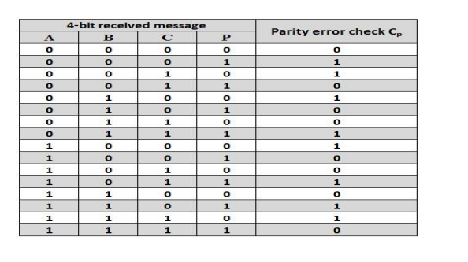
Even Parity Checker Consider that four input messages along with even parity bit is generated at the transmitting end. These 4 bits are applied as input to the parity checker circuit which checks the possibility of error on the data. If any error occurs, the received message consists of odd number of 1s.
Truth Table:
The above table shows the truth table for the even parity checker in which PEC = 1 if the error occurs, i.e., the four bits received have odd number of 1s and PEC = 0 if no error occurs, i.e., if the 4-bit message has even number of 1s.

Slide 6
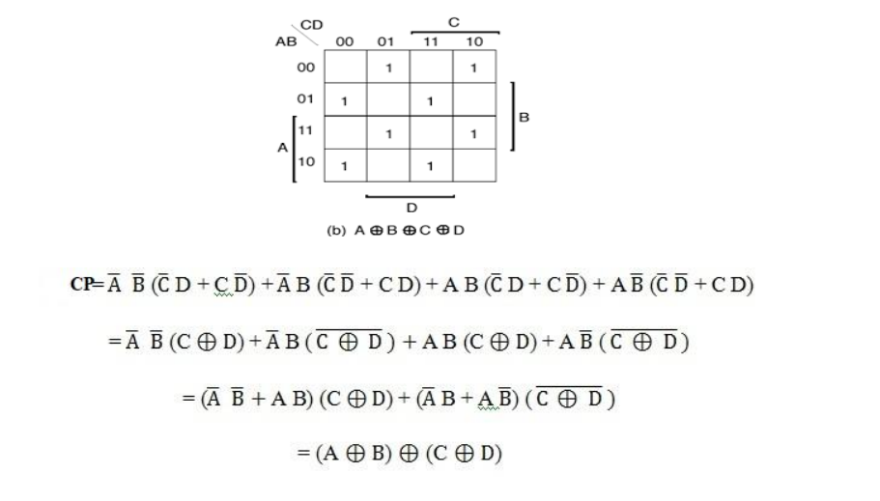
K-MAP:

Slide 7
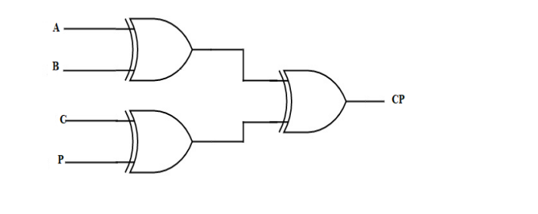
LOGIC DIAGRAM:
The logic expression for the even parity checker can be implemented by using three Ex-OR gates as shown in figure.
If the received message consists of five bits, then one more Ex-OR gate is required for the even parity checking.

Slide 8
Drawbacks:
If two bits are transposed (change places) then the computer could be fooled into thinking the data is correct and not corrupted.If two random bits change state then the system could also be fooled.
Parity bits can detect one error at a time. If two errors occur, there will be no detection
Advantages:
It is used to validate the integrity of the data.
Parity bits are often used in data transmission to ensure that data is not corrupted during the transfer process.

Slide 9
CONCLUSION:
The parity generator generates the parity bit in the transmitter and the parity checker checks the parity bit in the receiver.
The parity checker is needed to detect the errors in communication and also in the memory storage devices parity checker is used for testing.
The parity bit is also used in Small Computer System Interface (SCSI) and also in Peripheral Component Interconnect (PCI) to detect the errors
REFERENCES:
Donald P Leach, Albert Paul Malvino and GoutamSaha: Digital Principles and Applications, 7th Edition and onwards, Tata McGraw Hill, 2011.
https://technobyte.org/parity-generator-parity-checker/

